Slide 2
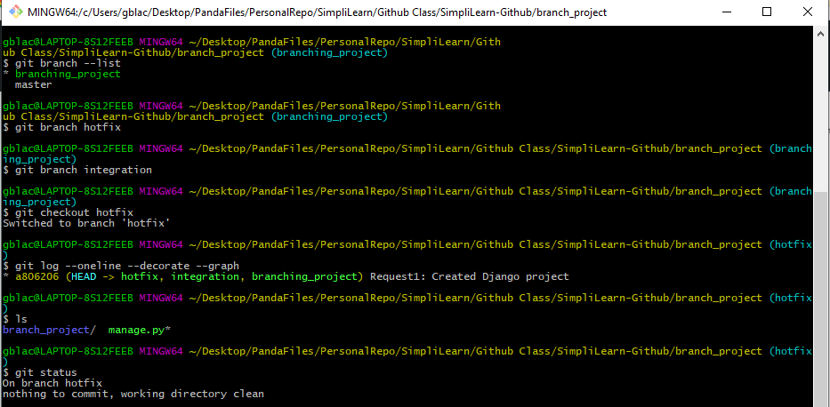
Adding Hotfix Branch

Slide 3
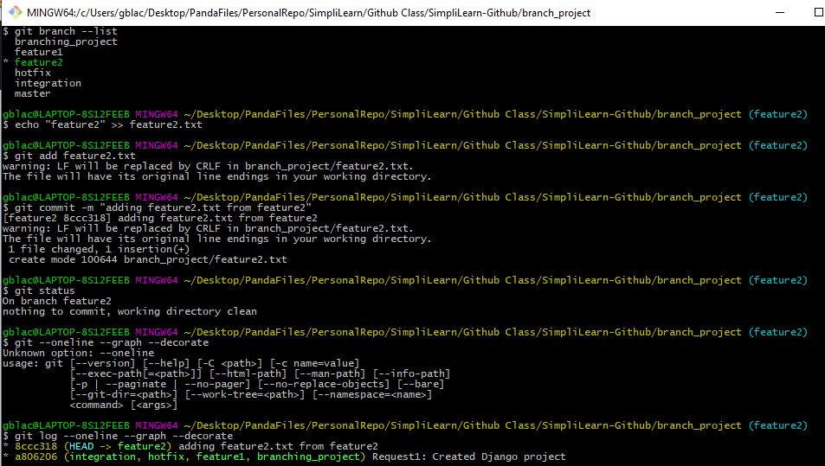
Adding Feature2.txt to Feature2 branch

Slide 4
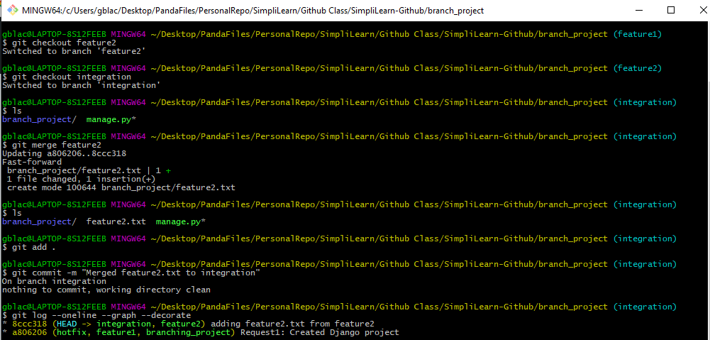
Merging feature2.txt to Integration Branch

Slide 5
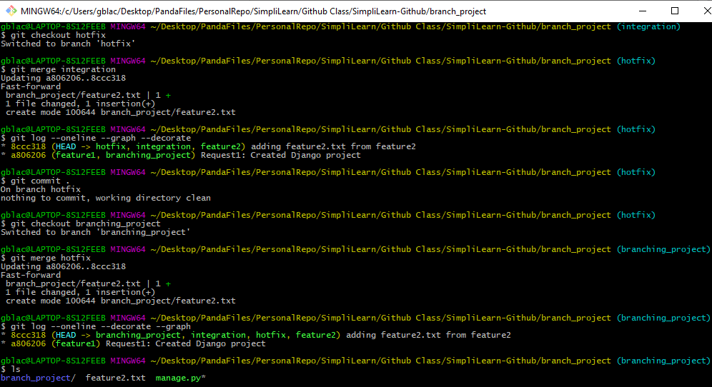
Merge Integration into Hotfix then Branching Project

Slide 6
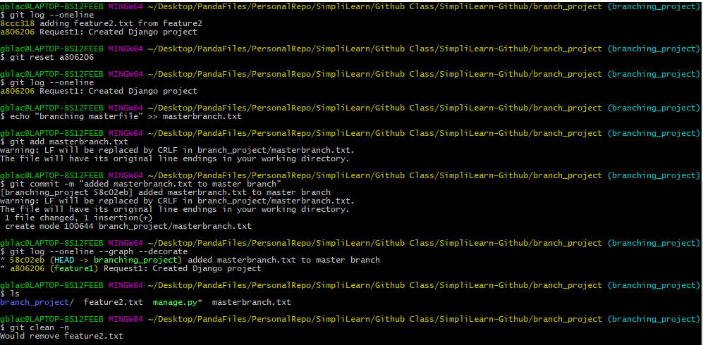
Forgot to add a file to Branching Project - (Reverting)

Slide 7
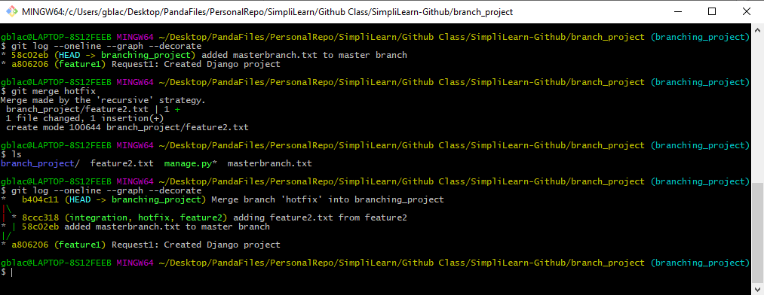
Merged Hotfix with Master (3-way merge)

Slide 8
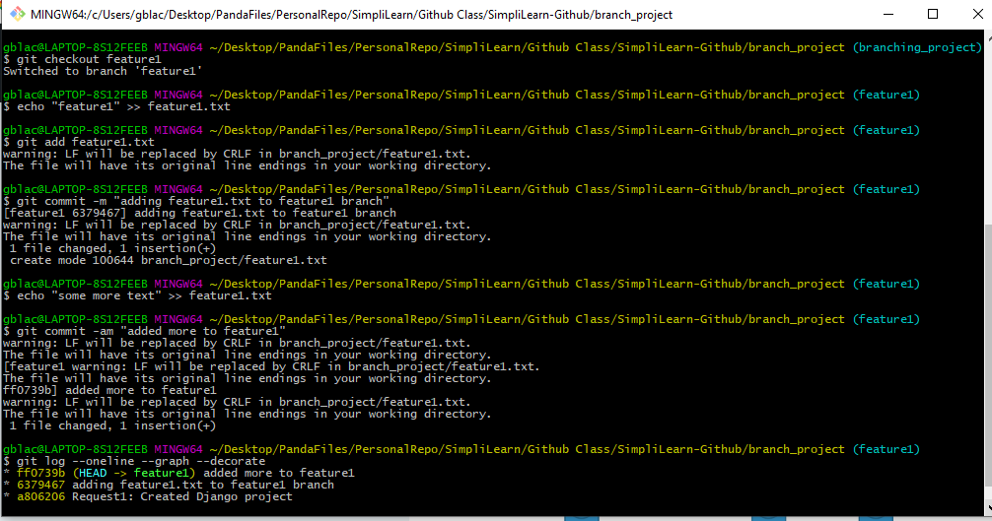
Added Feature1.txt and two commits to Feature1 Branch

Slide 9
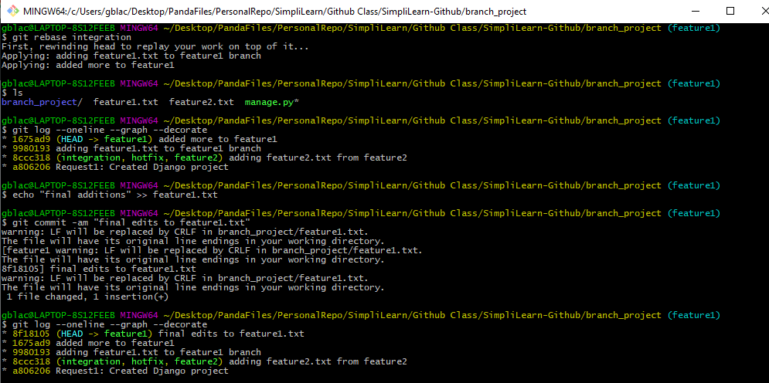
Rebasing Feature1 Branch with Integration Branch

Slide 10
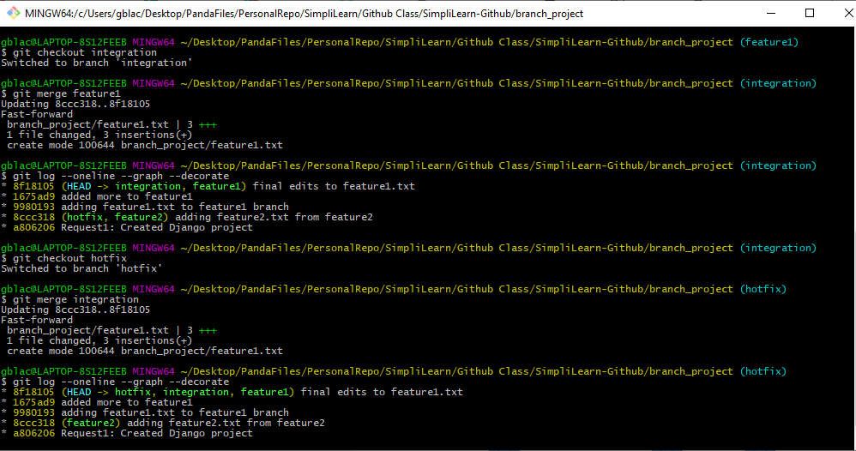
Merging Feature 1 to Integration then Integration to Hotfix

Slide 11
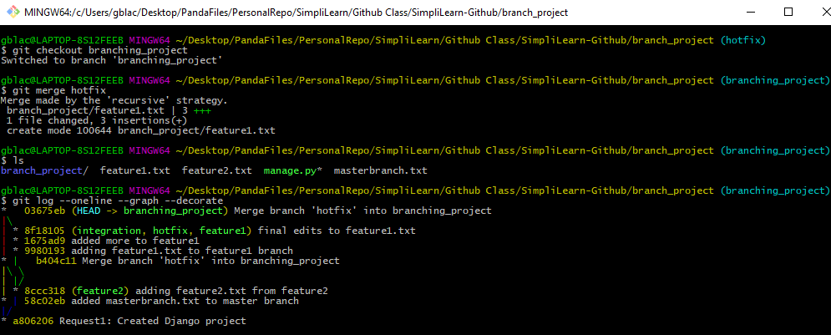
Merging Hotfix into Master (Conflict merge on ???)

Slide 12
Merging Hotfix into Master (Conflict merge on ???)

Slide 13
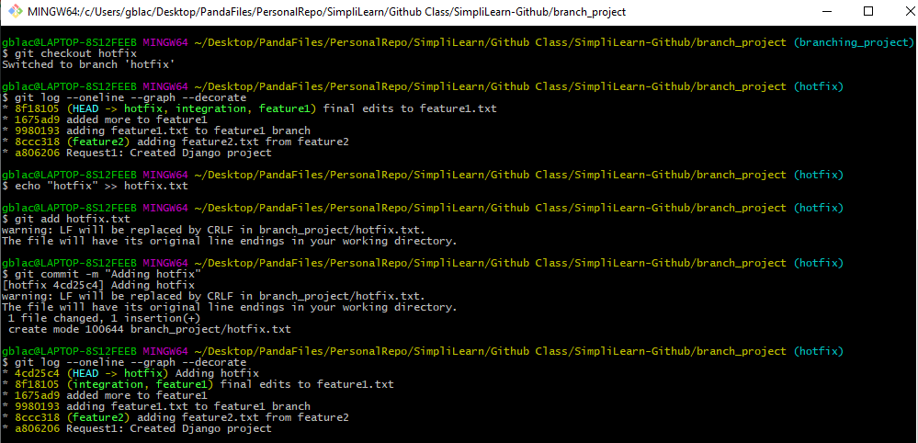
Checking out Hotfix and adding Hotfix.txt

Slide 14
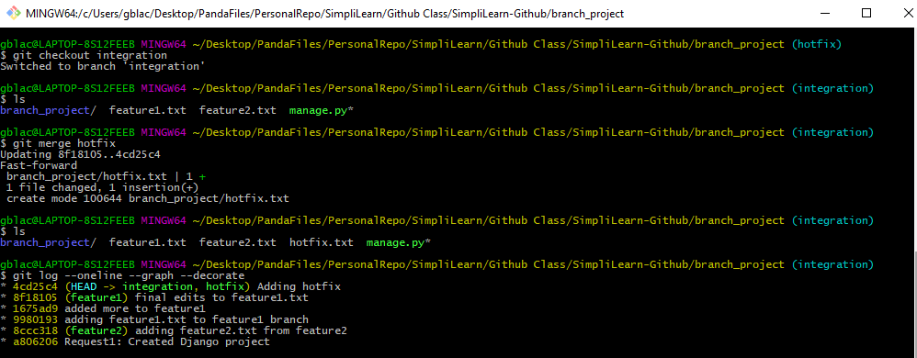
Merging Hotfix to Integration

Slide 15
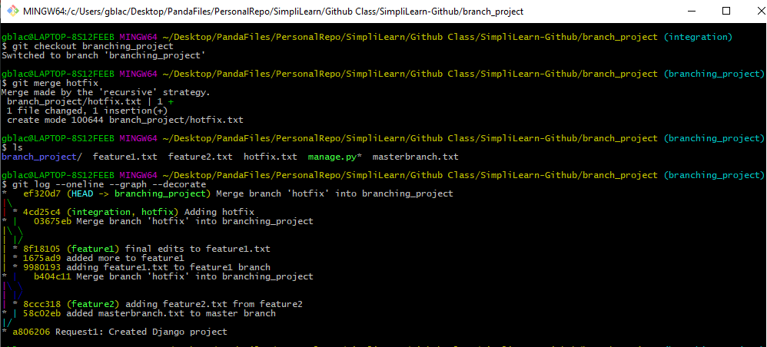
Merging Hotfix to Master

Slide 16
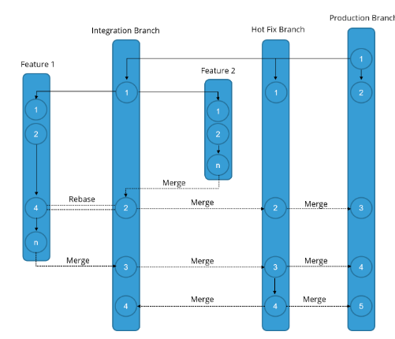
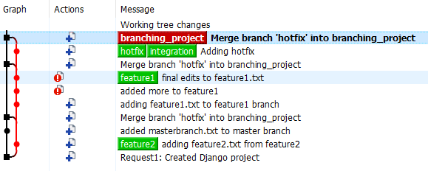
Branching Development Model
Branch = branching_project
5
4
3
2
1

Slide 17
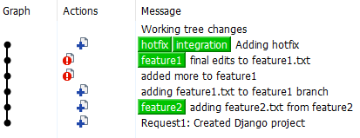
Branching Development Model
Branch = hotfix
4
3
2
1
Modifications to file occurred on a different branch. Commits were added in fast forward merge at #3.

Slide 18

Branching Development Model
Branch = feature 2
2
1

Slide 19
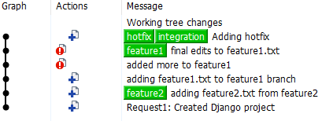
Branching Development Model
Branch = integration
4
3
2
1
Modifications to file occurred on a different branch. Commits were added in fast forward merge at #3.

Slide 20
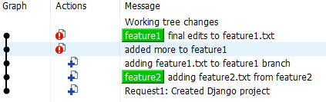
Branching Development Model
Branch = feature 1
5
2
4
1
Rebase at #4 rewrites feature2 to be added before adding feature1. This keeps the Integration, Feature2 and Feature1 branches consistent. Merge preserves history whereas rebase rewrites it.

